Slide 1
Fallout 19
By: Abraham, Aiden, Andrew, Joshua, Sven, and Xainab
Github: https://github.com/marbalino/ECON-148

Slide 2
Project Background

Slide 3


Context of the Pandemic
The COVID-19 pandemic made significant economic disruptions globally, especially in the U.S.
Led to widespread business closures, job losses, and changes in consumer behavior.
Low-wage workers faced higher unemployment rates and greater economic uncertainty compared to higher-wage workers.

Slide 4


The Economic Impacts of COVID-19 Authors
Raj Chetty
John N. Friedman
Renowned for his work on inequality and social mobility
A professor of economics and public policy at Brown University

Slide 5


The Economic Impacts of COVID-19 Authors
Michael Stepner
Opportunity Insights Team
A researcher in public economics and health policy
Uses big data to address economic inequality and enhance economic opportunities in the U.S.

Slide 6

Article
Explores the economic impact of the COVID-19 pandemic on the United States economy from Mar. 2020 - Dec. 2021.
Utilizes a public database constructed from private sector data, tracking the economic impact of the COVID-19 pandemic in and enabling the authors to report weekly statistics.
Consumer spending and employment rates

Slide 7

Findings
Uneven economic recovery across different income groups and regions!
Low-wage workers experienced a more significant and prolonged reduction in employment compared to high-wage workers.
Analyzed low-wage employment rates across counties, linking changes in employment to median rents and other economic conditions

Slide 8

Need for Quantitative Analysis
Crucial for understanding the economic impact of the pandemic.
Using detailed and up-to-date data, researchers can identify patterns and connections not evident in summary statistics.
Helps policymakers support specific groups and create effective interventions.
Valuable insights for addressing economic challenges.
Stronger recovery

Slide 9
Project Objective

Slide 10

Central Objective
Evaluate the effects COVID exposure and UI benefits have on low wage employment patterns
Notes:
The purpose of this project is to evaluate the effect of COVID-19 risk exposure and unemployment insurance extensions on low wage employment patterns across counties. This involves analyzing how varying levels of COVID-19 risk and changes in unemployment insurance policies influence employment rates and job recovery in different regions.
Importance
Understanding the differential impact of COVID exposure and UI extensions helps policymakers design more effective policies by identifying factors that most significantly impact economic recovery within different regions.
Insight gathered from this analysis assists in formulating strategies that balance public health with economic recovery (ie. if the data shows that areas with high COVID-19 risk but strong unemployment insurance support have better employment outcomes, it suggests that financial safety nets can help mitigate the economic impact of the pandemic. Limiting the impact of on the economy)

Slide 11

Process
Identify Required Dataframes
Covid Risk Data and Covid Cases Data
Employment Data
Unemployment Insurance Benefits Data
Recreate Existing Model
Data Integration
Define Variables
Model Estimation
Model Improvement
Explore Alternate Models
Model Selection
Document Findings
Compare Models
Find Biases
Conclusions
Notes:
The steps we will thus take to accomplish this objective is as follows:
First, we will identify the required dataframes. Those being dataframes with information of covid cases, risk, employment, unemployment benefits, and locational data.
Next, considering we did not have access to the code used by the authors, we will recreate the existing model.
This will consist of data integration such as merging dataframe together, cleaning, defining variables such as our dependent and independent variables, and lastly, model estimation consisting of estimating coefficients and evaluating the model’s fit.
Then, we will attempt to improve on our model:
This will consist of exploring alternative models and model selection (in other words comparing performance of different models using values such as R-squared)
Lastly, we will summarize our findings.
This will consist of our overall conclusion as well as other potential biases and errors that we have or may have encountered through our process.

Slide 12
Data Description

Slide 13
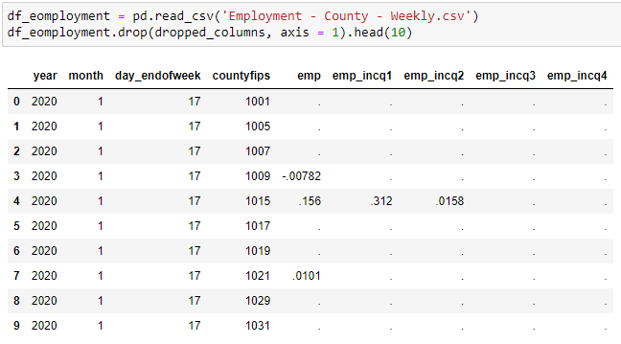
Paper of interest: “The Economic Impacts of COVID-19: Evidence from a New Public Database Built Using Private Sector Data
Data derived from various private sector sources to create a new public database
Anonymized, cleaned, and aggregated
Data included lots of details, and many aspects of economic activity are covered
The data collected was updated weekly throughout March 2020 - December 2021
The data is benchmarked against publicly available statistics
Notes:
Overview of all data as in what the data contains
-ie: employment, ui benefits, geo, etc

Slide 14
Dataframe Name & Granularity
FY2018_50_County_rev.csv
The granularity is at the county level and each row represents the amount of rent a homeowner pays relative to the state and county they live in.
Employment - County - Weekly.csv
The granularity is at the county level and each row represents the employment levels for a specific income bracket for a specified county at a point in time after January 4, 2020.
COVID - County - Daily 2021.csv
The granularity is at the county level and each row represents the COVID metrics for a specific county at a specific time. Essentially it gives all cases, death and vaccine rate, both new and old.
UI - Max Weeks - State.csv
Each row represents unemployment claims for a specific state at a specific point in time, detailing rates and counts of initial and continued claims across different unemployment programs.
GeoIDs - County.csv
The granularity is as the county level, with additional attributes that provide context about the county’s relationship to cities, commuting zones, states and population data for a given year.

Slide 15
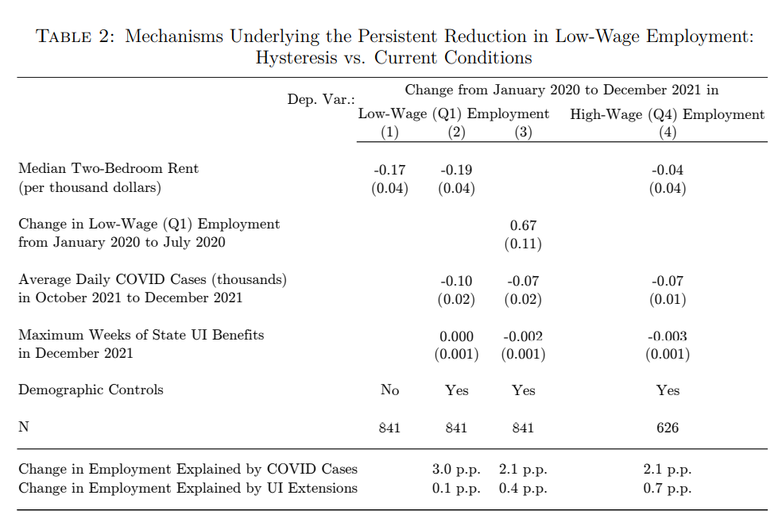
Target Variable
Changes in bottom-wage-quartile employment rates from Jan. 2020 – Dec. 2021
Explained Variables
Median Two Bedroom rents
Changes in Low-wage Employment from Jan. 2020 – Jul. 2020
Average Daily COVID-19 Cases from Oct. 2021 – Dec. 2021,
Maximum Weeks of State UI Benefits in 2021.
Note: Median two bedroom rents and maximum weeks of state UI benefits data obtained from outside sources (www.cbpp.org and www.huduser.gov/).
Notes:
Target Variable
Our target variable is the changes in bottom-wage-quartile employment rates specifically from Jan. 2020 – Dec. 2021 as shown in the stargazer table.
Explained Variable
Now our features include the median two bedroom rent, average daily covid cases, changes in low wage employment, and unemployment benefits all from this date range
One thing to note, is that data for median two bedroom rent and unemployment insurance benefits data was obtained from outside sources. Links shown above

Slide 16
Data Cleaning

Slide 17
Datasets Used
FY2018_50_County_rev.csv
Employment - County - Weekly.csv
COVID - County - Daily 2021.csv
UI - Max Weeks - State.csv
GeoIDs - County.csv

Slide 18
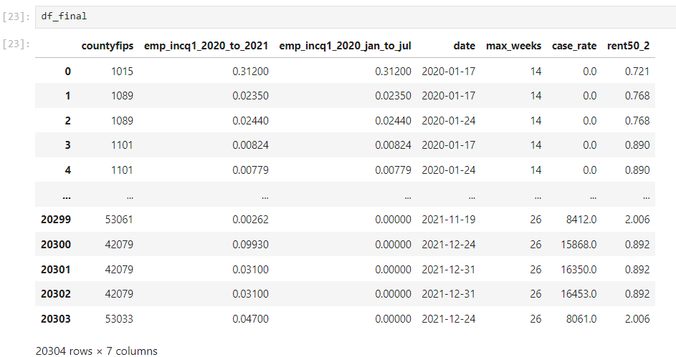
Dependent Variable
Combining all Data
Median Two-Bedroom Rent
(per thousand dollars)
Average Daily COVID Cases (thousands) in October 2021 to December 2021
Maximum Weeks of State UI Benefits in December 2021
Change in Low-Wage (Q1) Employment from January 2020 to July 2020
Grouped by

Slide 19
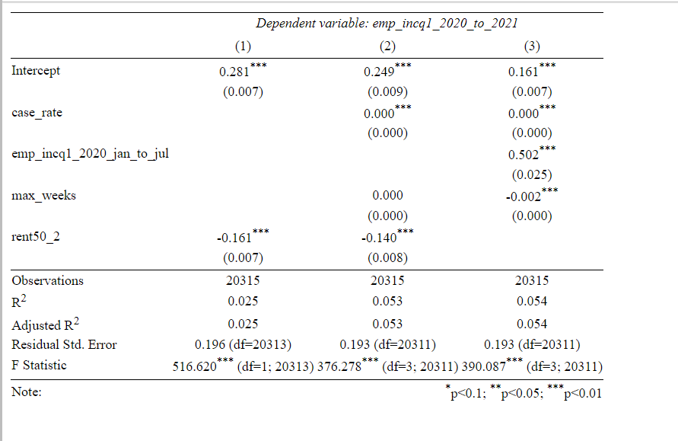
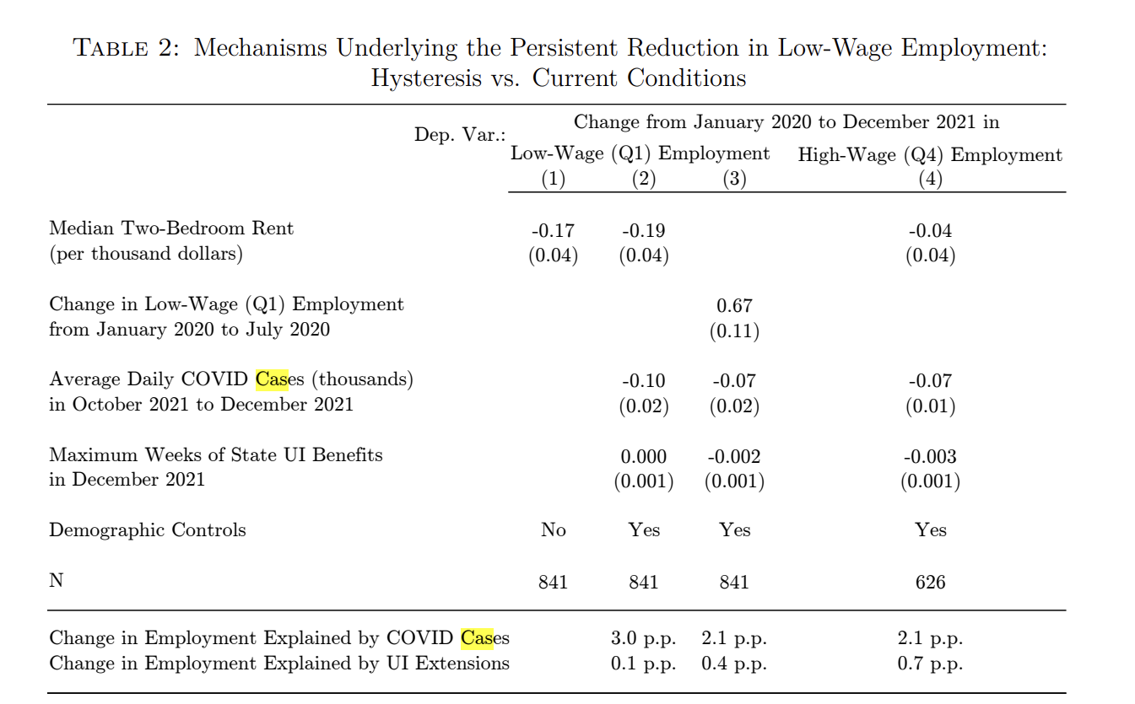
Replicated Results

Slide 20
Exploratory Data Analysis

Slide 21
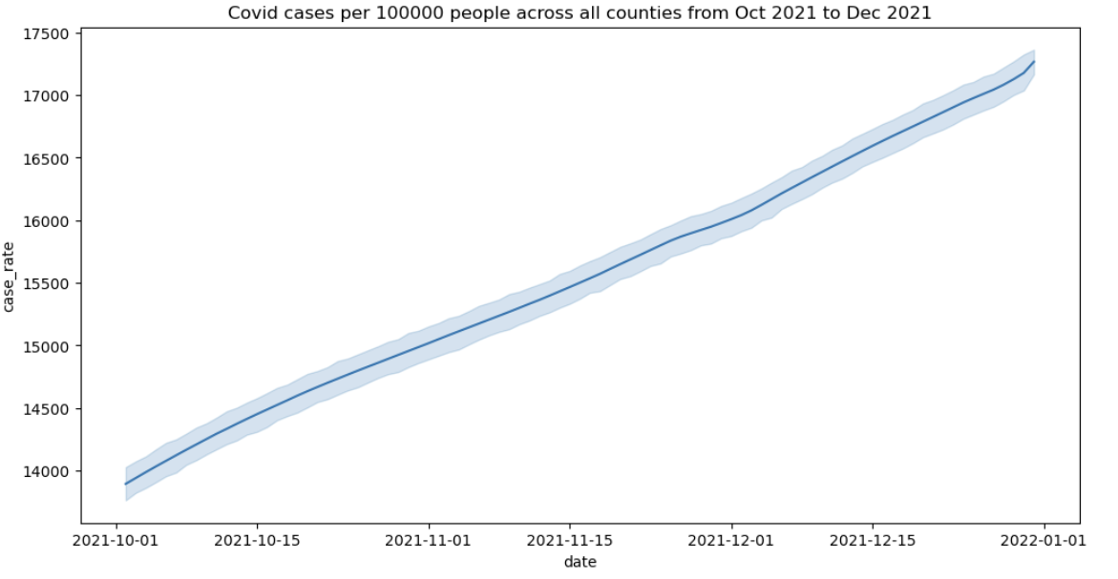

Slide 22
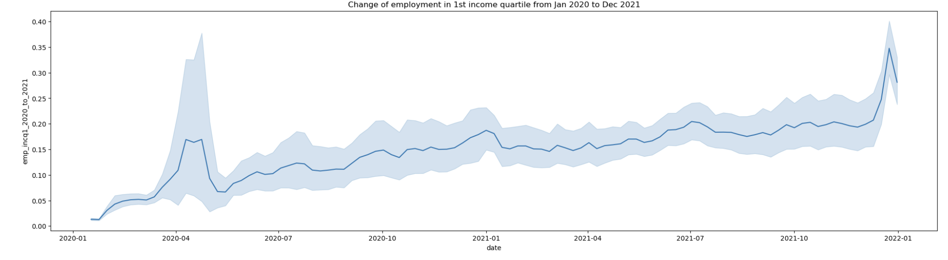
Notes:
Plots / shows the rate of change in employment amongst low wage workers / 1st income quartile workers across all counties. Looking at the plot, we see that this change of employment rate amongst the 1st quartile is relatively pretty slow, there’s a very small spike in employment rates around 2020 april, but we then again see a decrease around a month later, and from there the growth generally remains pretty slow

Slide 23
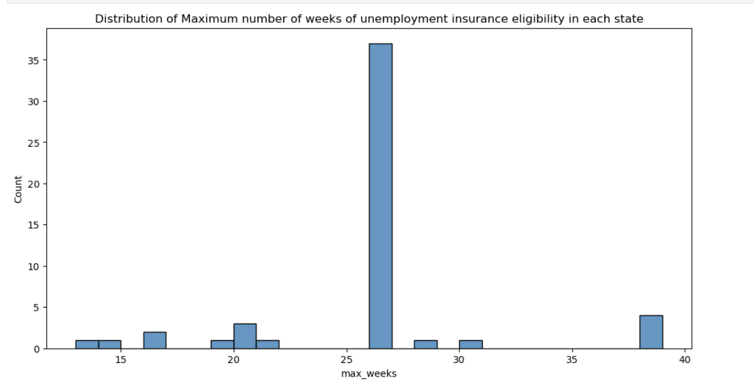
Notes:
Majority of states had around 26 max weeks of unemployment insurance eligibility

Slide 24
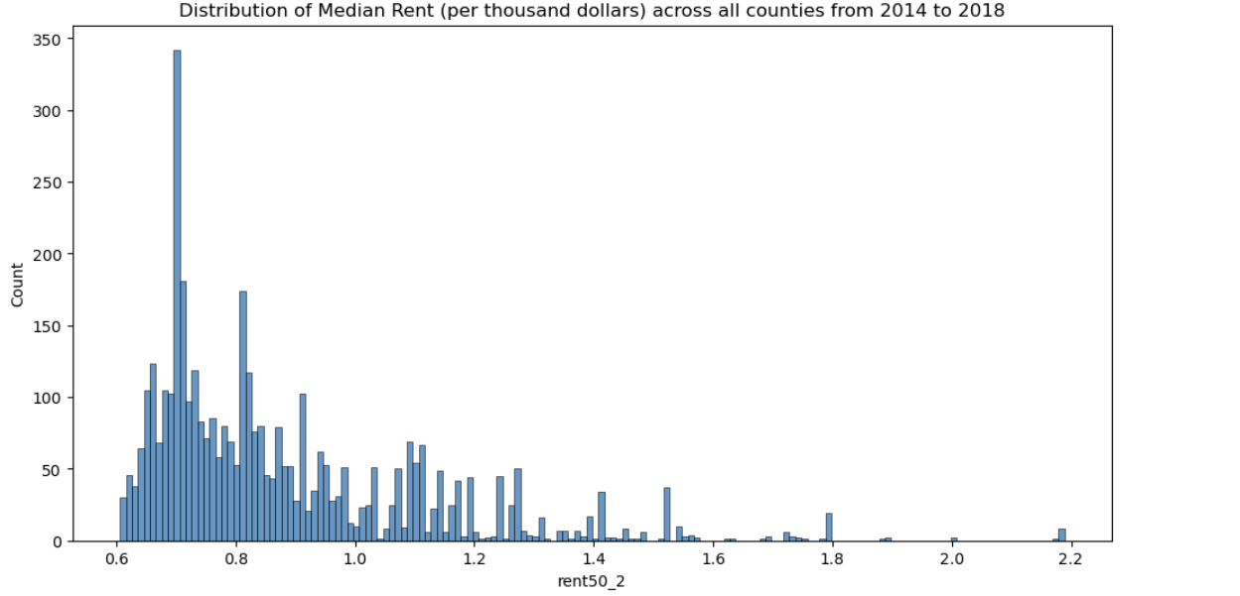
Notes:
The majority of the median rent falls between the range of $600 to $800 per month, we divided the rent by a 1000 here in the process of data cleaning so that our numbers were looking a little cleaner

Slide 25
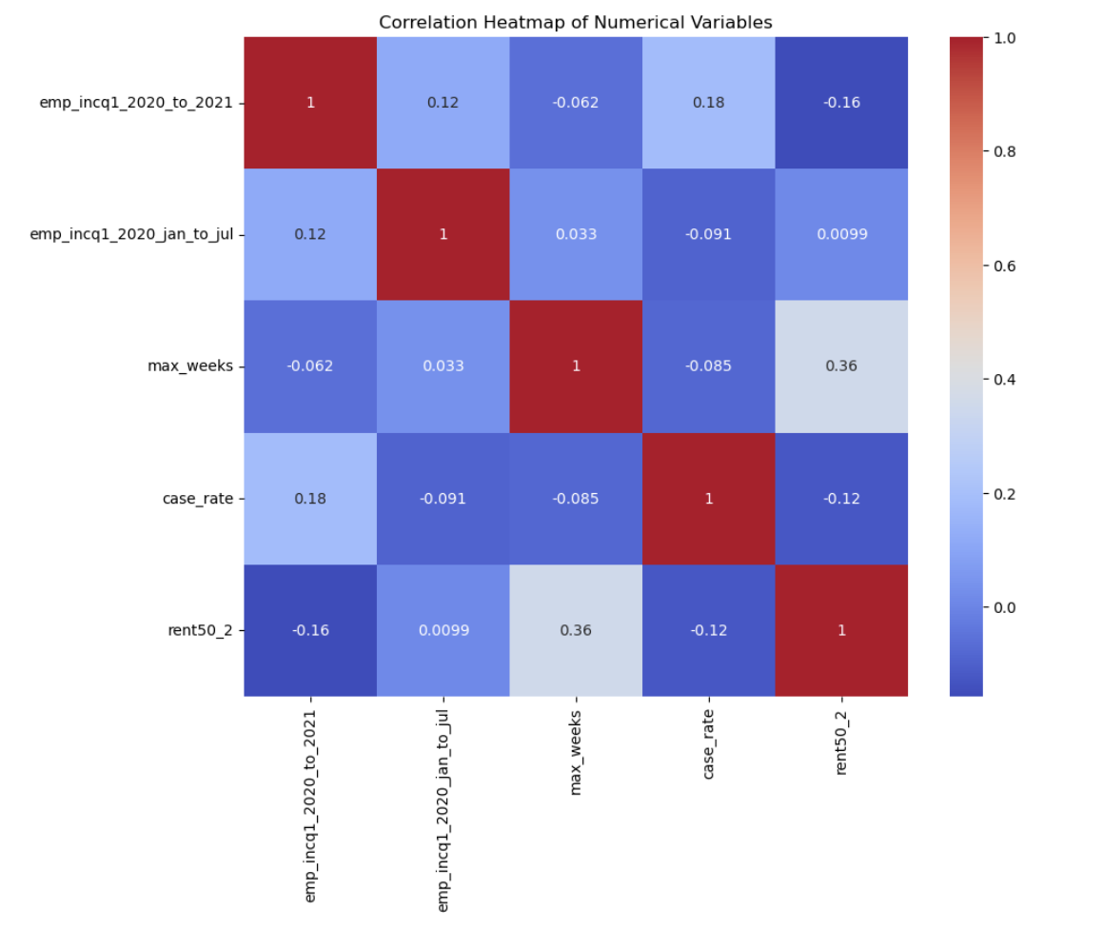
Notes:
We see a positive correlation between median rent and max weeks of unemployment benefits, suggesting

Slide 26
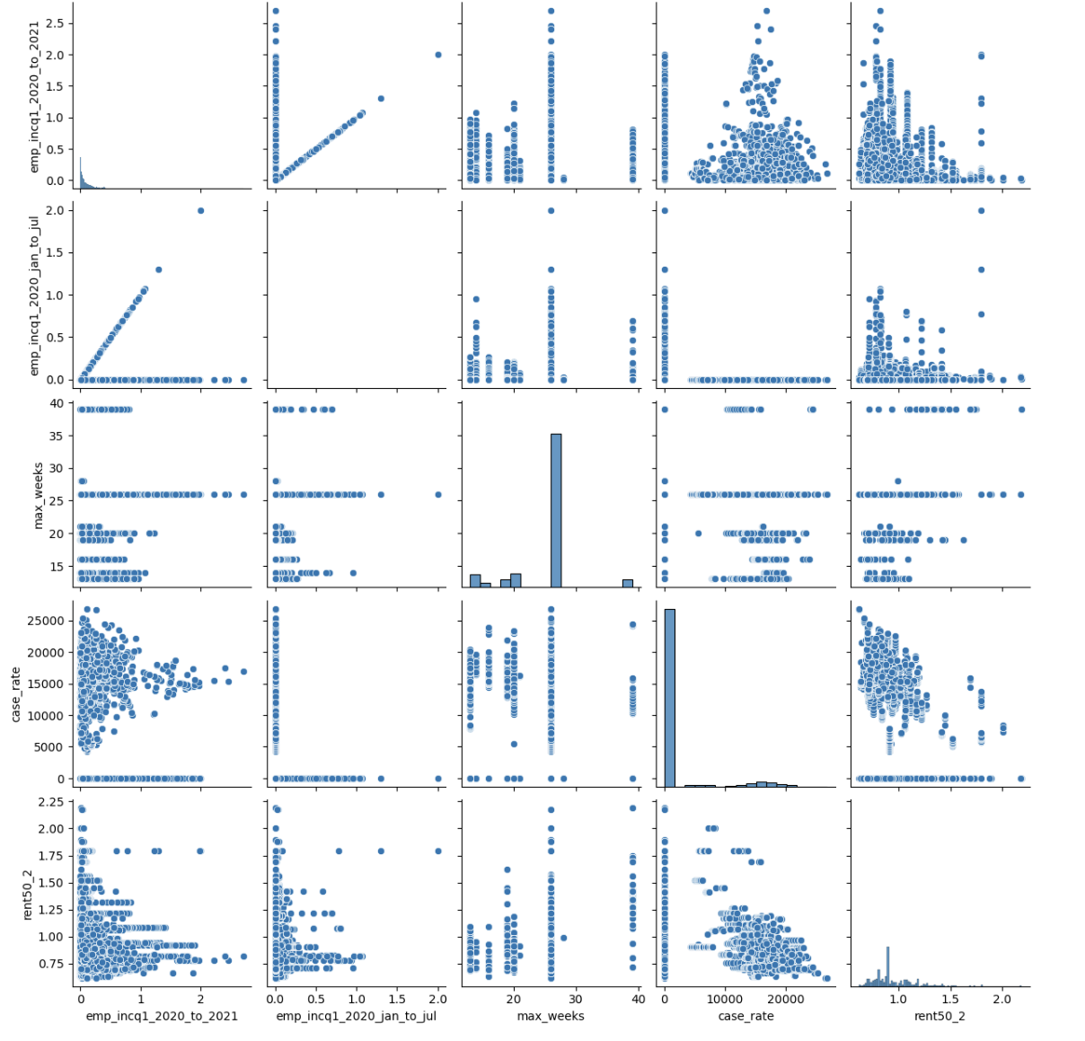

Slide 27
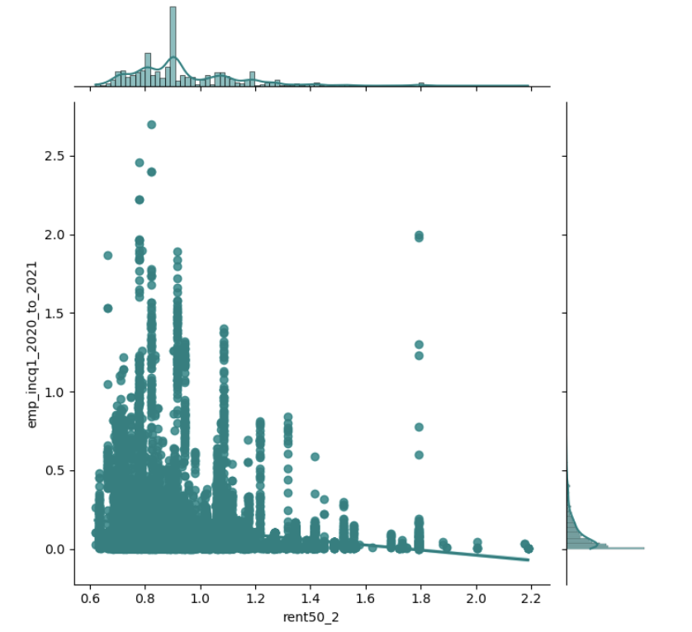
1st income quartile employment rates
vs median 2 bedroom rent

Slide 28
Modeling

Slide 29
Results from our ols econometric models

Slide 30
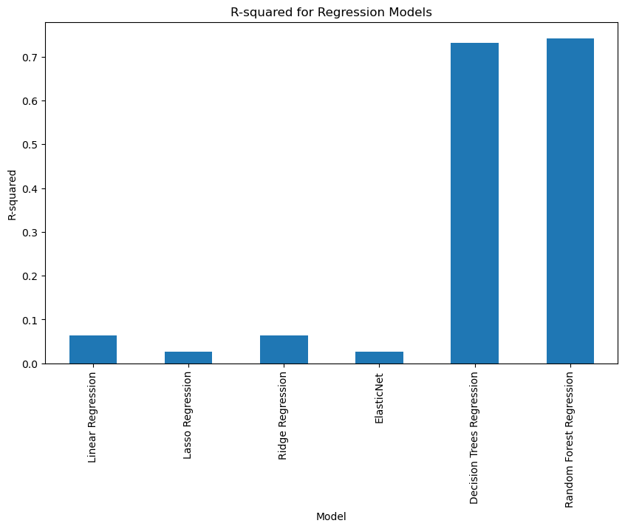
Other regression models we explored

Slide 31
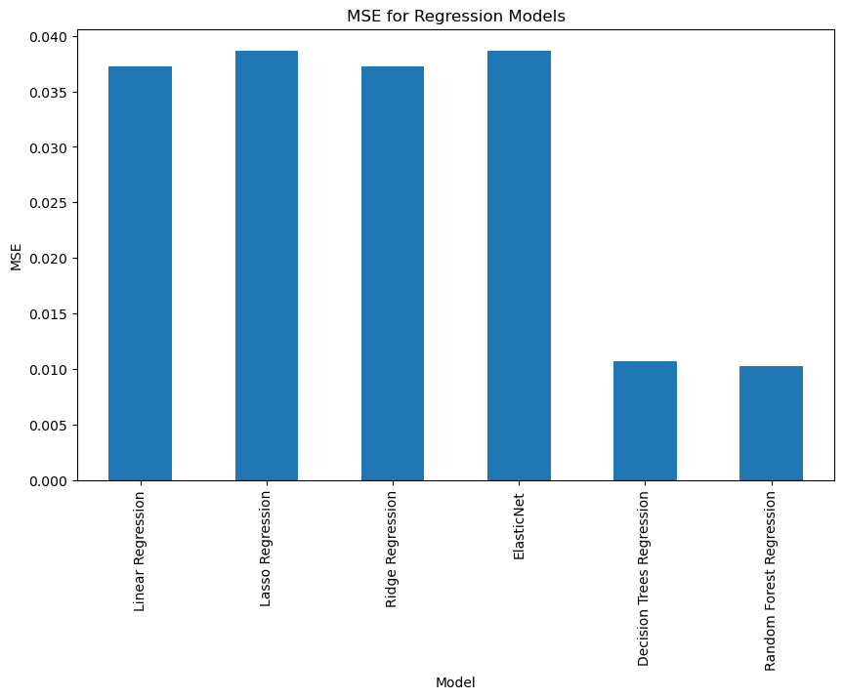

Slide 32
Biases in Data

Slide 33
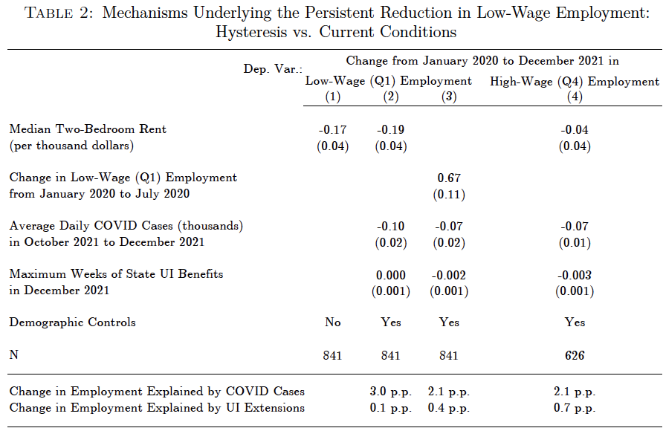
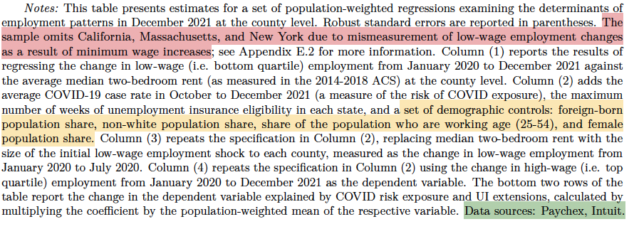
Exclusion of certain states: California, Massachusetts, and New York are omitted from the sample due to mismeasurement of low-wage employment changes related to minimum wage increases. This exclusion can lead to a geographical bias
Choice of Controls: While the inclusion of demographic controls may help account for demographic differences, there could still be unobserved variables influencing employment patterns. The control variables selected may not fully capture all the factors affecting employment, such as local economic policies or industry-specific shocks

Slide 34
Demographic data unavailable:
Demographic data is unavailable for us to use. This may lead to flaws in our models as this demographic data may have had some effect on the dependent variable in our model (changes in bottom wage quartile employment) that we are unable to explore/measure. This also makes it harder to use our model to make generalizations to the larger US population that has this demographic diversity
Data sources: All the data used is sourced from Paychex and Intuit, which may not be fully representative of all employment patterns, especially for small businesses and informal employment
Clientele Bias: Each data series reflects the specific clientele of the data provider, which may not be representative of the overall population. This affects the ability to generalize conclusions to larger populations​
Issue with population weighted regression: In the description of the data used, it is mentioned that the model is a population weighted regression. While this can help make the analysis of the data more representative, it can also lead to issues like overrepresentation in areas that are more densely populated versus areas that might have more sparse population

Slide 35
Interpretation and Conclusions

Slide 36

Model Performance
RMSE
Overfitting
Model Complexity

Slide 37
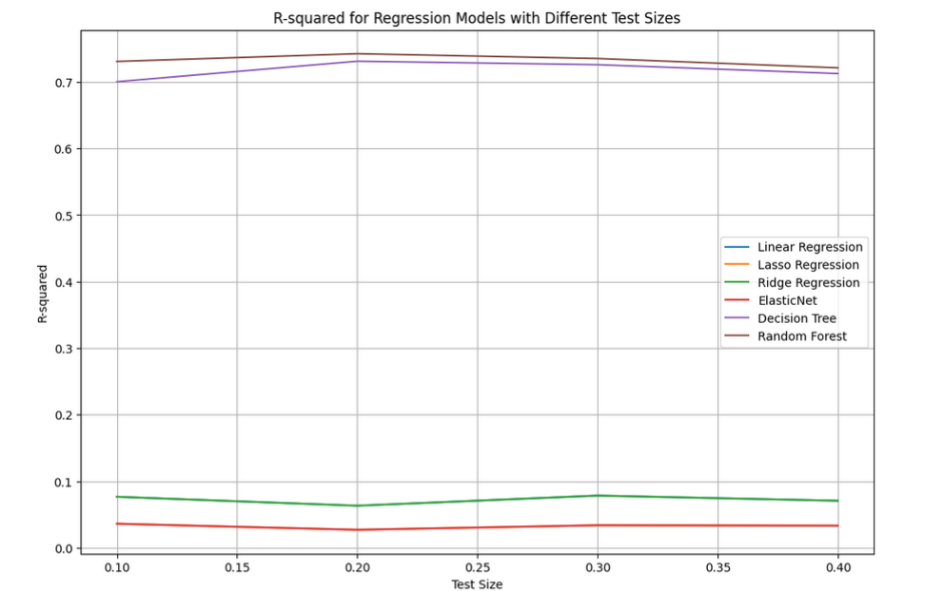
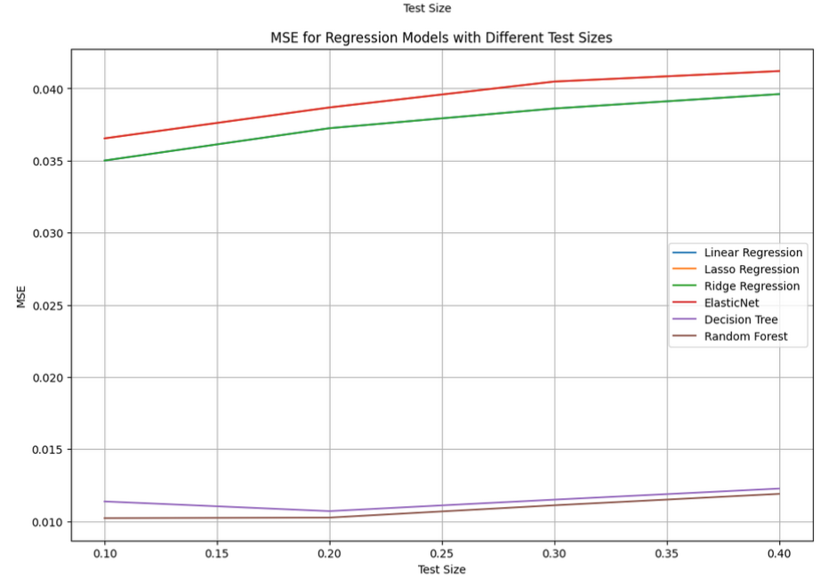
Model Performance

Slide 38
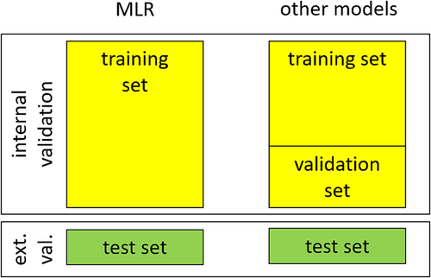
Training and Test sets
To help prevent and understand possible over fitting that occurs within our model split out data set into a validation and test set in order.
Training set = 80%
Test set = 20%
Notes:
We use the training data to fit our model and then use the validation data to test the performance of the model with unseen data points.

Slide 39
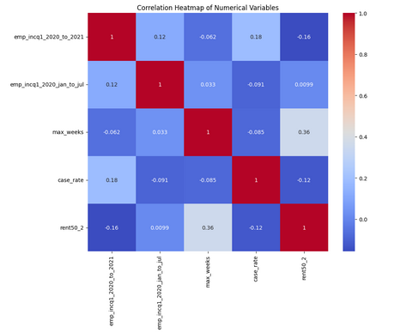
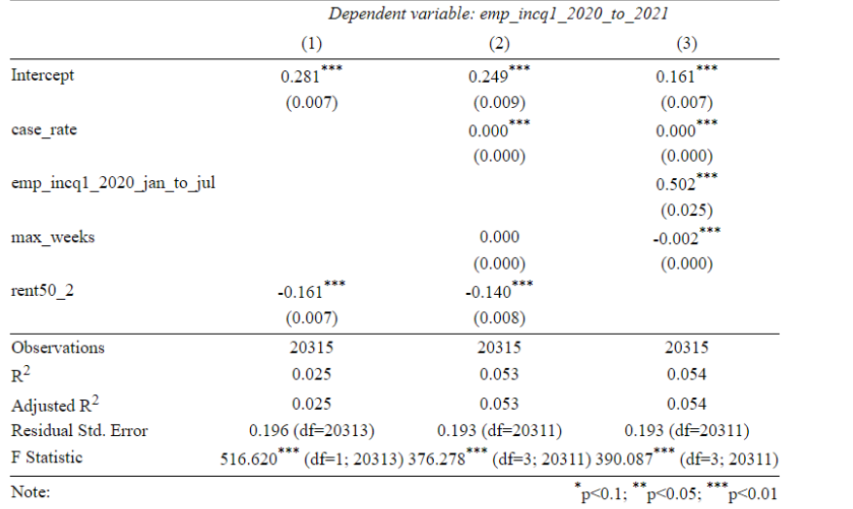
PCA

Slide 40
Interpreting Performance Metrics from OLS
R squared: As we increased the number of features we more than doubled our R squared value. Although it is quite low we still consider these results to be significant
Standard errors: As we increased the number of features standard error dropped slightly
F-statistic: As we increased the number of features F-Statistics varied but tended to decrease

